Slide 1
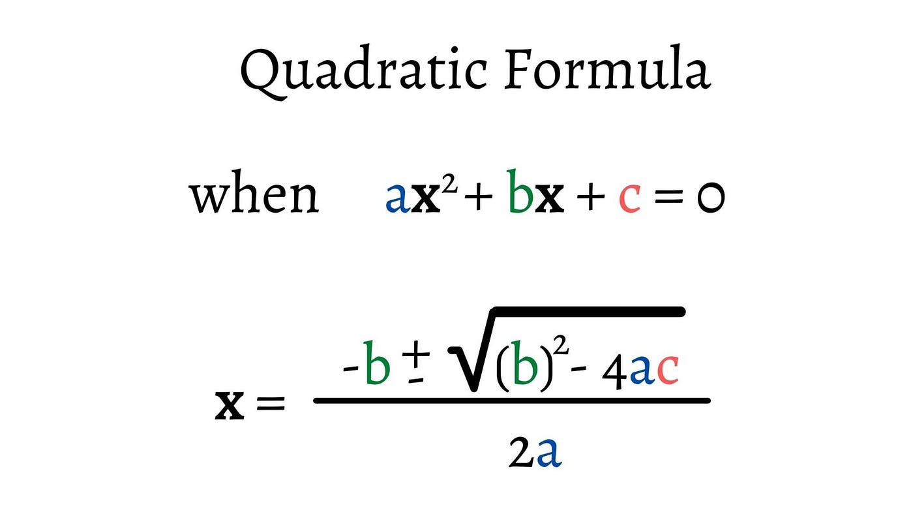
In math, we define a quadratic equation as an equation of degree 2, meaning that the highest exponent of this function is 2.
The standard form of a quadratic is y = ax^2 + bx + c, where a, b, and c are numbers and a cannot be 0. Examples of quadratic equations include all of these: y = x^2 + 3x + 1.

Slide 2
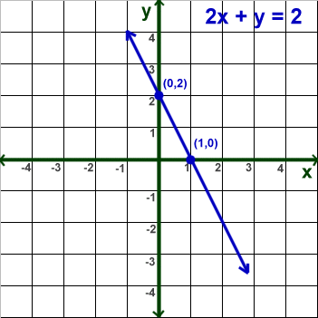
A linear equation is an equation that represents a straight line when graphed on a coordinate plane. It has the general form:
Y=mx+b
where:
*y is the dependent variable
x is the independent variable
m is the slope of the line (the rate of change of yyy with respect to xxx)
b is the y-intercept (the value of y when x is 0)

Slide 3
Logarithm:
A logarithm is a way of counting how many time do you need multiply a number by it’s self to get another number.
Simple Example
Let's consider a simple example with base 10:
log10​(100)=2
This means that 10 raised to the power of 2 equals 100:
102=100

